Slide 1
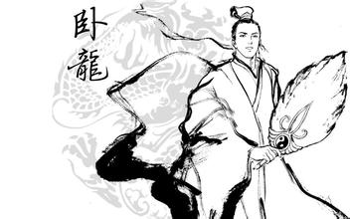
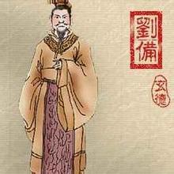
(Discrete) Mathematics Behind Interactive Proof
01101010…
Merlin/Prover
Arthur/Verifier
Jun Yan (颜俊)
tjunyan@jnu.edu.cn
Jinan University

Slide 2
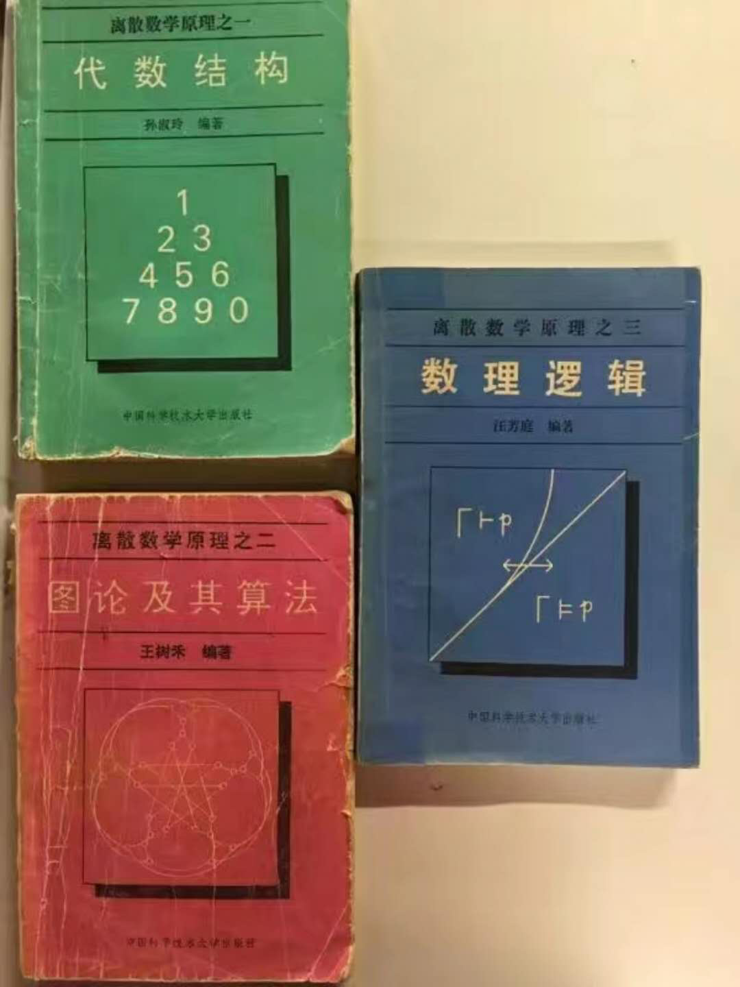

Discrete mathematics from computer theorist’s view
Number theory
Linear algebra
Abstract algebra
Graph theory
Probability theory
Mathematical logic
Coding theory
…

Slide 3
Roadmap
Interactive proof
Zero-knowledge proof
Quantum security and my works
Conclusion

Slide 4
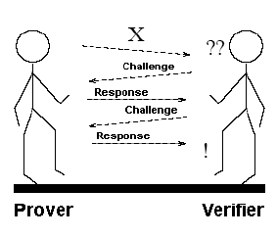
Part 1. Interactive Proof

Slide 5
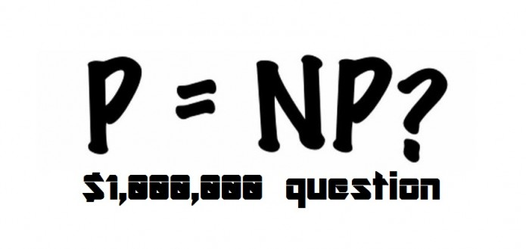
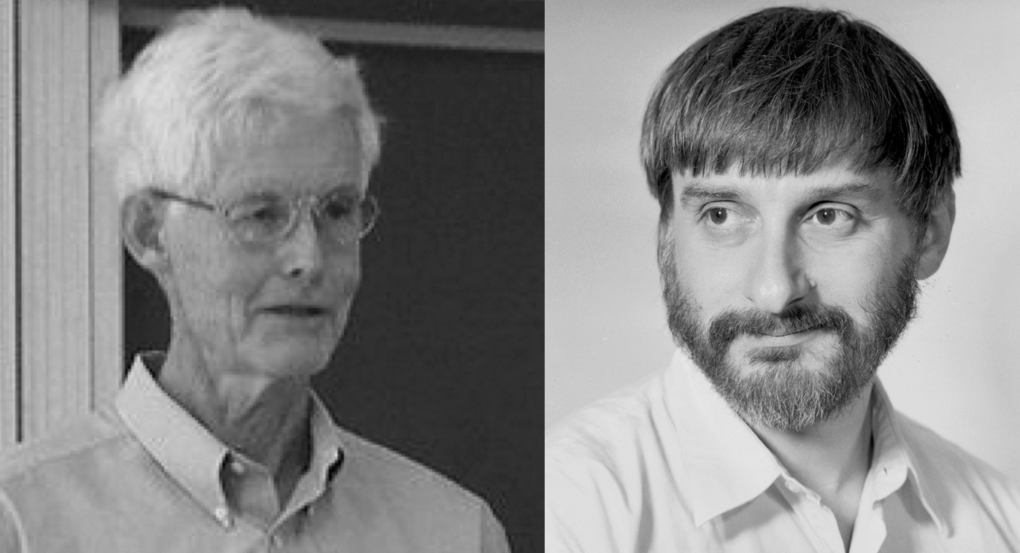
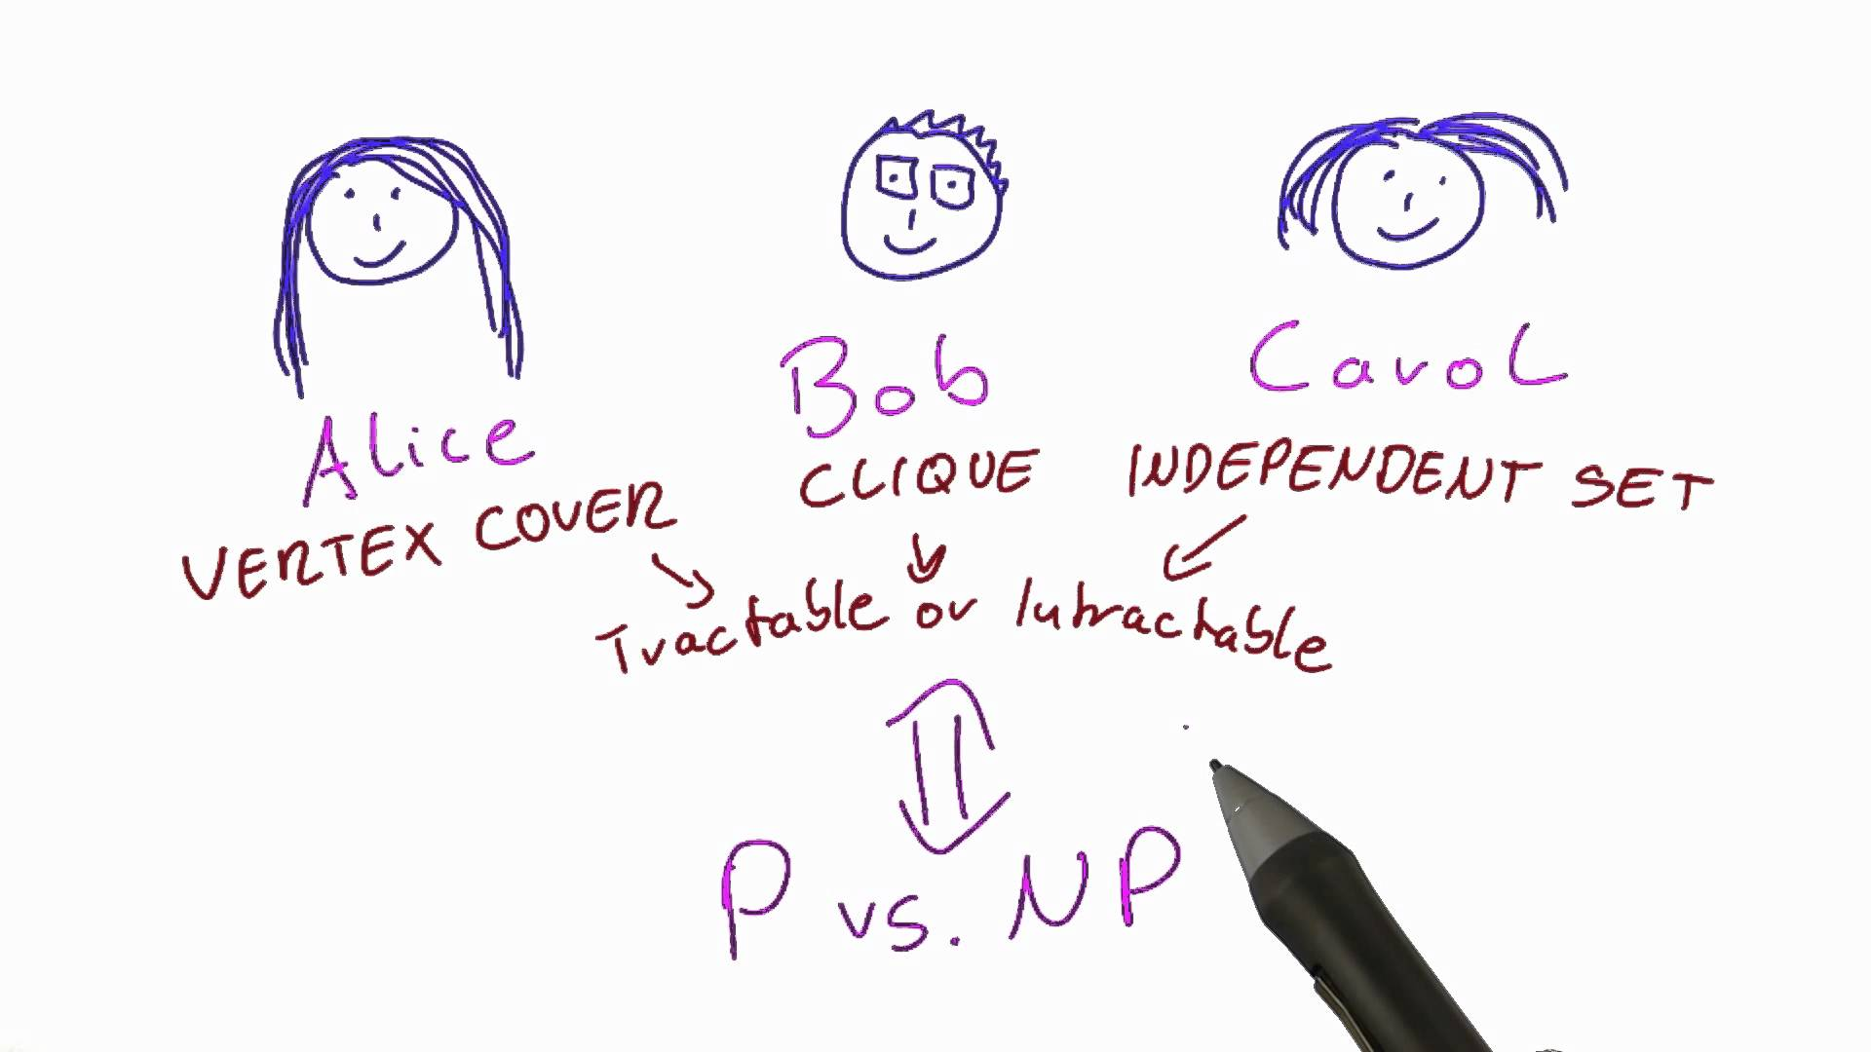
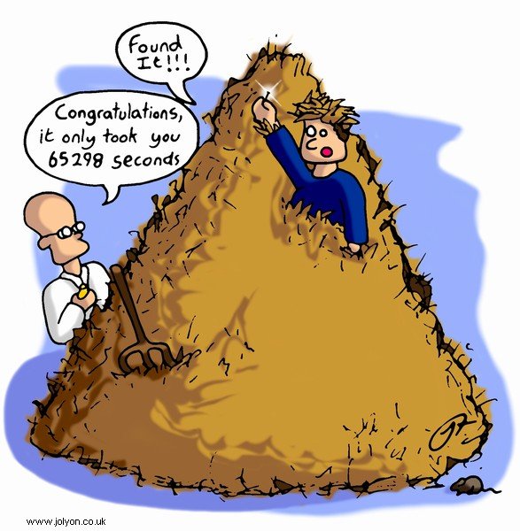
Cook
Levin
Cook-Levin Theorem: SAT is NP-complete.
Finding a needle in a haystack

Slide 6
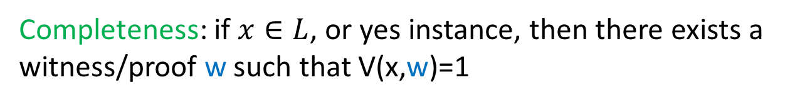
NP proof system
Completeness: if $x∈L$, or yes instance, then there exists a witness/proof w such that V(x,w)=1
Soundness: if $x∉L$, or no instance, then for any w, V(x,w)=0
w
Prover
Verifier
Notes:
Explain what are the meanings of completeness and soundness in Mathematical logic

Slide 7

What about coNP?
Prove that there does not exist a short witness
Example: Graph Non-Isomorphism
1
1
2
3
2
3
4
5
4
5
6
6
Notes:
Not isomorphism because node 1 in the first graph has degree 4, which is larger than degrees of any nodes in the second graph

Slide 8

An interactive proof system for GNI
Prover
Verifier
1.
2.
3.
Notes:
WLOG G_0 and G_1 have the same vertex set V (Verifier can check this, and reject otherwise).

Slide 9
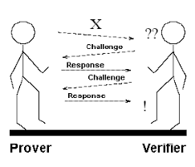
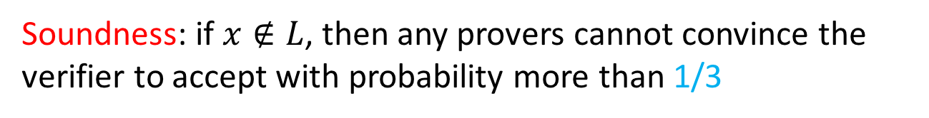
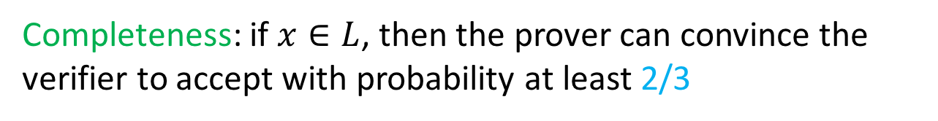
Interaction + Randomness
Completeness: if $x∈L$, then the prover can convince the verifier to accept with probability at least 2/3
Soundness: if $x∉L$, then any provers cannot convince the verifier to accept with probability more than 1/3
Errors can be reduced in exponential speed by the sequential/parallel repetition

Slide 10
Interactive proof
Common Input x
Random coins_{V}
Random coins_{P}
m₁
Prover
computationally
unbounded
m₂
Verifier
polynomial
time
m₃
m_{k}
accept

Slide 11
#SAT --- #P-complete problem
#SAT = {$(Φ,K)$: $Φ$ is a 3CNF formula and has exactly K satisfying assignment}
E.g. $Φ=\left(x_{1}∨¬x_{2}∨x_{3}\right)∧\left(x_{2}∨¬x_{3}∨x_{4}\right)∧(¬x_{1}∨x_{3}∨¬x_{4})$
How to prove this is true?

Slide 12
Sumcheck protocol for #SAT
The first attempt: input: φ(x₁, x₂, …, x_{n})
  prover: “I claim φ has k satisfying assignments”
  true iff
    φ(0, x₂, …, x_{n}) has k₀ satisfying assignments
    φ(1, x₂, …, x_{n}) has k₁ satisfying assignments
    k = k₀ + k₁
  prover sends k₀, k₁ (verifier can compute the reduced boolean formula)
  verifier sends random c ∈{0,1}
  prover recursively proves “φ’ = φ(c, x₂, …, x_{n}) has k_{c} satisfying assignments”
  at end, verifier can check for itself.

Slide 13
Analysis of the first attempt:
  Completeness: φ(x₁, x₂, …, x_{n}) has k satisfying assignments ⇒ accept with prob. 1
  Soundness: φ(x₁, x₂, …, x_{n}) does not have k satisfying assigns. ⇒ accept prob. ≤ 1 – 2^{-n}
  Why? It is possible that k is only off by one; verifier only catches prover if coin flips c are successive bits of this assignment
Notes:
Soundness: cheating successfully once will ensure the prover to succeed

Slide 14
Solution:
  replace {0,1}^{n} with (F_{q})^{n}
  verifier substitutes random field element at each step
  Two different polynomials of degree less than d agree on at most d points

Slide 15
Arithmetization
  transform φ(x₁, … x_{n}) into polynomial p_{φ}(x₁, x₂, … x_{n}) of degree d over a field F_{q}; q prime > 2^{n}
  recursively:
    x_{i} → x_{i} • ¬φ → (1 - p_{φ})
    φ ∧ φ’ → (p_{φ})(p_{φ’})
    φ ∨ φ’ → 1 - (1 - p_{φ})(1 - p_{φ’})
  for all x ∈ {0,1}^{n} we have p_{φ}(x) = φ(x), i.e. agree on boolean inputs
  degree d ≤ |φ|

Slide 16
Prover wishes to prove:
k = Σ_{x1 = 0, 1}Σ_{x2 = 0,1} … Σ_{xn = 0, 1}p_{φ}(x₁, x₂, …, x_{n})
Define polynomial p₁(x) = Σ_{x2 = 0,1} … Σ_{xn = 0, 1}p_{φ}(x, x₂, …, x_{n})
prover sends polynomial p₁ (x)
verifier:
  checks that p₁(0) + p₁(1) = k
  sends random z₁ ∈ F_{q}
continue with proof that
p₁(z₁) = Σ_{x2 = 0,1} … Σ_{xn = 0, 1}p_{φ}(z₁, x₂, …, x_{n})
at end: verifier checks for itself

Slide 17
The actual protocol
Prover
Verifier
p₁(x)
p₁(x) = Σ_{x2,…,xn ∈ {0,1}} p_{φ}(x, x₂, …, x_{n})
p₁(0)+p₁(1)=k?
pick random z₁ in F_{q}
z₁
p₂(x) = Σ_{x3,…,xn ∈ {0,1}} p_{φ}(z₁, x, x₃, …, x_{n})
p₂(x)
p₂(0)+p₂(1)=p₁(z₁)?
pick random z₂ in F_{q}
z₂
p₃(x) = Σ_{x4,…,xn ∈ {0,1}} p_{φ}(z₁, z₂, x, x₄ …, x_{n})
p₃(x)
p₃(0)+p₃(1)=p₂(z₂)?
pick random z₃ in F_{q}
. .
p_{n}(x)
p_{n}(0)+p_{n}(1)=p_{n-1}(z_{n-1})?
pick random z_{n} in F_{q}
p_{n}(z_{n}) = p_{φ}(z₁, z₂, …, z_{n})?

Slide 18
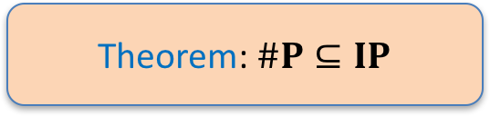
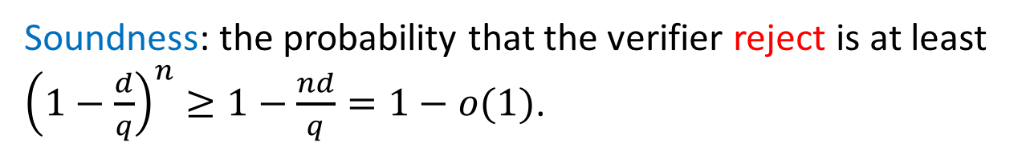
Completeness:
Soundness: the probability that the verifier reject is at least ${\left(1−\frac{d}{q}\right)}^{n}≥1−\frac{nd}{q}=1−o(1)$.
Theorem: $\#P⊆IP$

Slide 19
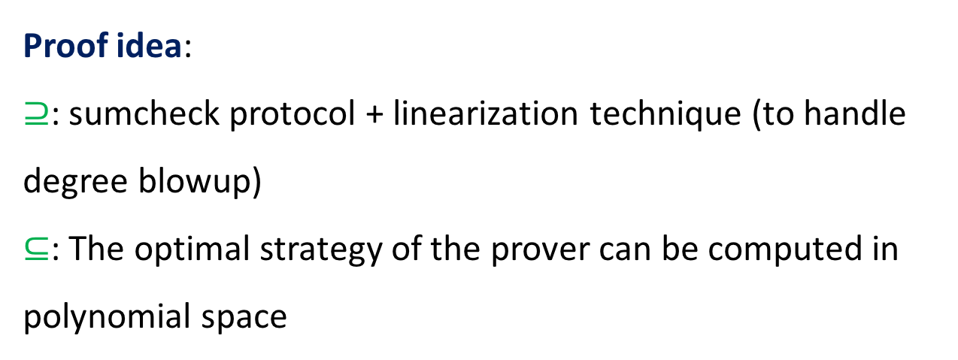
The actual power of interactive proof
Theorem: IP = PSPACE
Proof idea:
$⊇$: sumcheck protocol + linearization technique (to handle degree blowup)
$⊆$: The optimal strategy of the prover can be computed in polynomial space

Slide 20

What about multi-provers?
Police interrogation
More provers is less powerful to cheat the verifier
More algebrize techniques
Theorem: MIP = NEXP

Slide 21
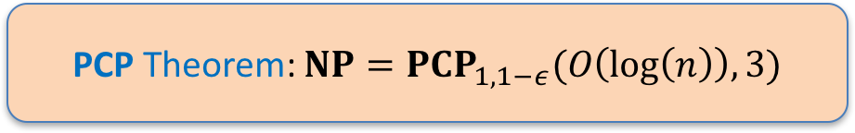
Scaling it down: back to NP
PCP Theorem: $NP=PCP_{1,1−ε}(O\left(\log\left(n\right)\right), 3)$
1
0
0
1
1
0
0
1
Hide it, and gives it to the verifier
Verifier: picks constant number of cells randomly
Accept/reject (with some error) according to the check

Slide 22
Why is it important?
Numerous applications:
  (In)approximation
  Protocols design: succinct zero-knowledge argument in block chain
  …

Slide 23
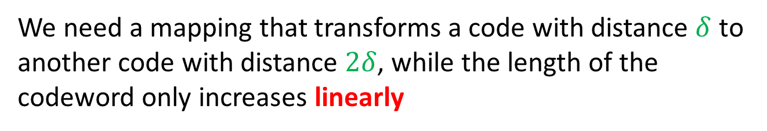
High-level idea: error-correcting code
We need a mapping that transforms a code with distance $δ$ to another code with distance $2δ$, while the length of the codeword only increases linearly
Proof techniques:
Algebrize techniques: like sumcheck protocol
Expander graph
Coding theory: Walsh-Hadamard code

Slide 24
Expanding Graphs - Properties
Combinatorial: no small cuts, high connectivity
Probabilistic: rapid convergence of random walk
Algebraic: small second eigenvalue
Theorem. [Cheeger, Buser, Tanner, Alon-Milman, Alon, Jerrum-Sinclair,…]: All properties are equivalent!

Slide 25
S
d
∀S |S|< n/2
|E(S,S^{c})| > α|S|d (what we expect in a random graph), α constant

Slide 26
Deterministic error reduction
G [2^{n},d, 1/8]-graph
G explicit!
B_{x}
_{{0,1}}^{n}
_{random}
_{strings}
Pr[error] < 1/3
|B_{x}|<2^{n}/3
r₁↓
r↓
r_{k}↓
x→
Alg
x→
Alg
x→
Alg
Majority
Thm [Chernoff] r₁ r₂…. r_{k} independent (kn random bits)
Thm [AKS] r₁ r₂…. r_{k} random path (n+ O(k) random bits)
then Pr[error] = Pr[|{r₁ r₂…. r_{k} }∩B_{x}}| > k/2] < exp(-k)
Notes:
First randomly choose a vertex, and then random walk. It will hit the bad set with high probability.

Slide 27
Part 2. Zero-knowledge proof
Trust me, for no reason
010101110
OK
Merlin/Prover
Arthur/Verifier

Slide 28

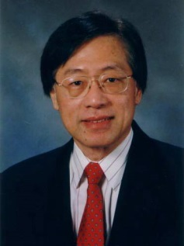
First tea
?
=
First water
Turing Award Winner:
Andrew Yao

Slide 29
How to prove these two ways are different even to a person who lost taste sense?
Repeat many times to increase confidence.
Solution:
Randomly chooses:
0: Tea to water
1: Water to tea
0 or 1
Merlin: Omniscient but untrustworthy wizard
Arthur: Skeptical, polynomial-time king

Slide 30
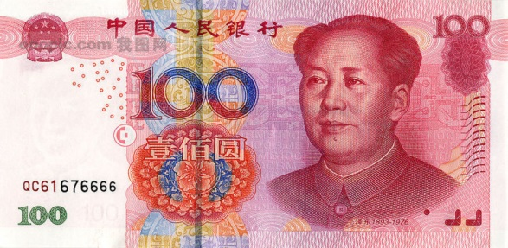
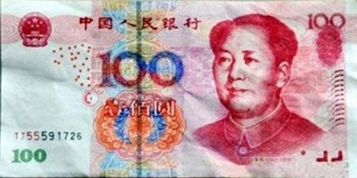
Are they different?
(except for the No.)
Prove this to a blind person

Slide 31
Another look at the Graph Non-Isomorphism protocol
input: (G₀, G₁)
Prover
Verifier
H = π(G_{c})
flip coin c ∈ {0,1}; pick random π
if H ≅ G₀ r = 0, else r = 1
r
accept iff r = c
*The prover just responds with something that the verifier has already known

Slide 32

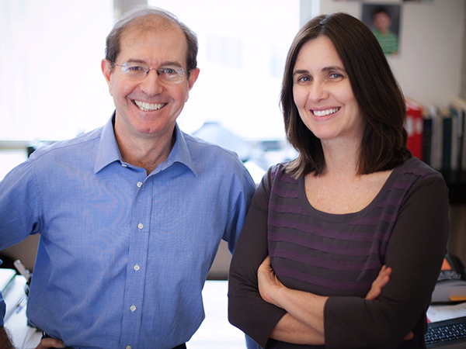
Zero-knowledge proof
”Proofs that Yield Nothing But Their Validity” --- [GMW91]
In particular, the witness is not leaked (witness hiding) for NP languages
Micali
Goldwasser

Slide 33
ZK proof for Graph Isomorphism
Common input: G₀ , G₁ (φ : G₀ ~G₁ )
Randomly choose π,
set H=π(G₁)
completeness
P
H
V
Randomly choose i=0 or1
i
Soundness
Soundness error1/2，but we can reduce it by sequential repetition
If i=1, set Ψ= π
If i=0, set Ψ= πoφ ⁻¹
Ψ
V accpts iff
Ψ : G_{i} ~ H
Theorem:Graph Iso. has a ZK proof system

Slide 34
The complexity of Graph Isomorphism
Unlikely to be NP-complete unless the Polynomial Hierarchy collapses
Babai’s recent breakthrough: a quasi-polynomial time algorithm, use some group theory

Slide 35
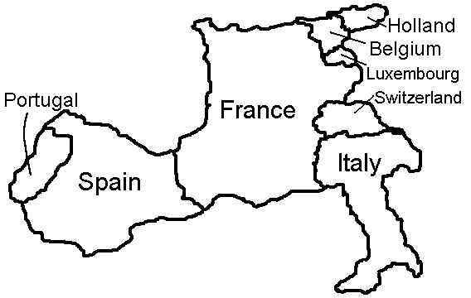
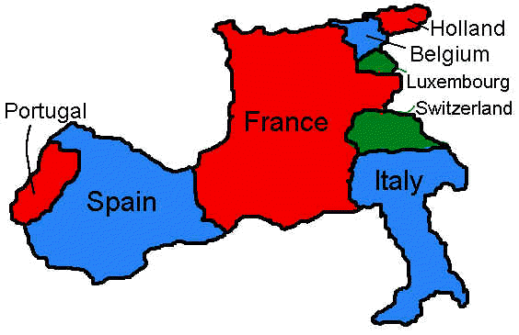
MAP 3-COLORING
Given: a map M
Decide: can it be colored
w/3 colors s.t. no two
adjacent countries have
the same color?
Formally: 3-COL(M)=1 iff M is 3-colorable.
http://www.ctl.ua.edu/math103/

Slide 36
GRAPH 3-COLORING
Given: a graph G
Decide: can it be colored
w/3 colors s.t. no two
adjacent vertices have
the same color?
Formally: 3-COL(G)=1 iff G is 3-colorable.
Fact: 3-COL is NP-complete.

Slide 37
GRAPH 3-COLORING
a 3-colorable graph
a non-3-colorable graph

Slide 38

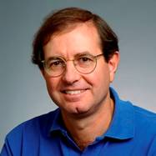
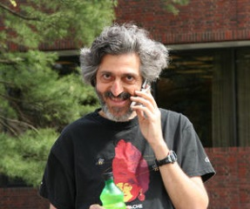
1
Zero-Knowledge Proof
1
1
2
2
2
3
3
4
4
3
4
5
5
5
Goldreich
Micali
Widgerson
Convince
Arthur
Merlin

Slide 39

Merlin’s action:
Chooses a random color permutation.
1
1
1
2
2
2
3
3
3
4
4
Puts all the vertices’ colors inside envelopes.
4
5
5
5
And sends them to the Arthur.

Slide 40
Arthur’s action:
Receives envelopes supposedly containing a legal 3-coloring of the input graph
1
1
2
2
3
3
4
4
Chooses an edge at random.
5
5
And asks Merlin to open the 2 envelopes.

Slide 41
Merlin opens the envelopes, revealing the colors.
1
1
2
2
Arthur accepts if the colors are different.
3
3
4
5
* Intuitively, ZK because Arthur sees a pair of random different colors

Slide 42
3-COL Proof System
3-coloring
C of V
Prover
graph G
Verifier
1. Choose random
permutation π of
{R,G,B}. Let C′= π(C).
“commit” to coloring C′
2. Choose random
edge (x,y).
(x,y)
“reveal” C′(x), C′(y)
3. Accept if
C′(x)≠C′(y)

Slide 43
ZK proof for Hamiltonian Cycle
G
C
1
2
1
2
4
3
4
3
1
2
3
4
1
2
3
4

Slide 44
commitments of π(G)
Prover
(Chinese Merlin)
Verifier
(Chinese Arthur)
Challenge b=0 or1
Check that the revealed graph is π(G)
b=0: permutation π + key
to explain
b=1: Hamiltonian cycle c + key
Check that a Hamiltonian cycle is opened

Slide 45

Digital envelop/locked box: commitment scheme
Two-stage interactive protocol between two parties, sender and receiver
Digital realization of a locked box
b
b

Slide 46

Commit stage
(Borrow animations from Iftach Haitner and Omer Reingold.)
Hiding: the receiver can’t distinguish it is committing 0 or 1.
S
R
b
Notes:
opaque

Slide 47

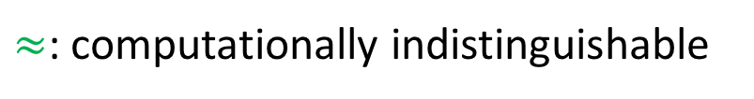
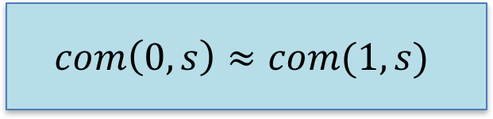
Formally a little bit
Computationally hiding (non-interactive case):
$$com\left(0,s\right)≈com(1,s)$$
where $com(⋅,⋅)$ denotes the sender’s message and s is the random coins used.
$≈$: computationally indistinguishable

Slide 48
Reveal stage
Binding: the sender can’t change her mind, i.e. changing b into it 1-b
S
R
b

Slide 49
Formally a little bit
Statistically binding (non-interactive case):
There does not exist $s,s′$ such that
$$com\left(0,s\right)=com(1,s′)$$
Canonical opening: the sender just sends randomness s, and the receiver verifies the sender’s computation

Slide 50
How to commit a binary string?
In a bit-by-bit fashion, or equivalently, commit in parallel
…

Slide 51
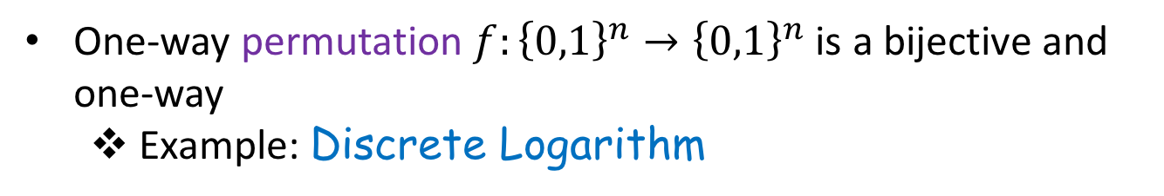
Construction from one-way permutation
One-way function:
  Easy to compute but hard to invert
  E.g. multiplication is easy; factoring is hard
x
easy
f(x)
hard
One-way permutation $f:{\left\{0,1\right\}}^{n}→{\left\{0,1\right\}}^{n}$ is a bijective and one-way
  Example: Discrete Logarithm

Slide 52
Step 1. From one-way permutation to pseudorandom generator
Step 2. From pseudorandom generator to bit commitment scheme

Slide 53
Definition of PRG
A Pseudorandom Generator is an efficient program which stretches short random seeds into long (polynomial bounded) pseudorandom sequences.
Efficiency
Seed
Mmmm…
They look the same to me!
PRG
Stretching
Pseudorandom Sequence
Efficient
Algorithm
Random Sequence

Slide 54
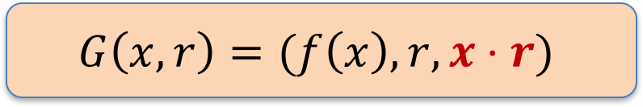
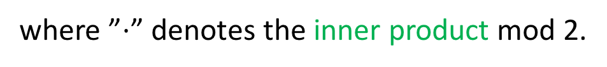
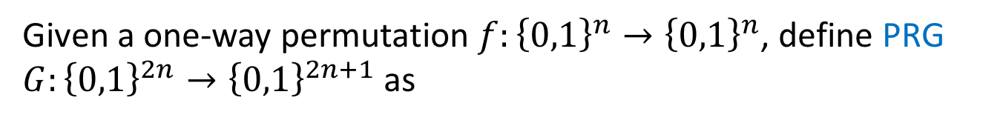
Construction
Given a one-way permutation $f:{\left\{0,1\right\}}^{n}→{\left\{0,1\right\}}^{n}$, define PRG $G:{\left\{0,1\right\}}^{2n}→{\left\{0,1\right\}}^{2n+1}$ as
$$G\left(x,r\right)=(f\left(x\right), r, x⋅r)$$
where ”$⋅$” denotes the inner product mod 2.

Slide 55
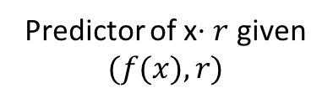


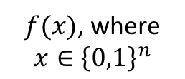
Security analysis
A’
$f(x)$, where $x∈{\left\{0,1\right\}}^{n}$
A
f(x)
x$⋅r$
$$x$$
r
Predictor of x$⋅r$ given $(f(x),r)$
Given access to adversary A, construct A’ to break the one-wayness
Notes:
For contradiction

Slide 56



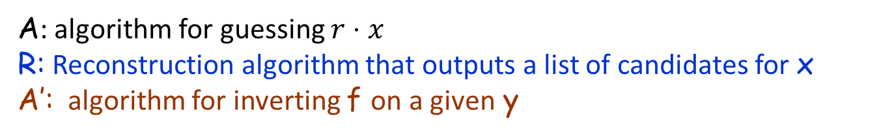
A: algorithm for guessing $r⋅x$
R: Reconstruction algorithm that outputs a list of candidates for x
A’: algorithm for inverting f on a given y
A’
y
R
y
y,r₁
A
?
z₁ =r₁ $⋅$ x
y,r₂
A
?
z₂ =r₂ $⋅$ x
☹
y,r_{k}
A
?
z_{k} =r_{k} $⋅$ x
z₁, z₂, ☹ z_{k}
x¹ ,x² ☹ x^{k’}
x_{i}=x
Check whether f(x^{i})=y

Slide 57
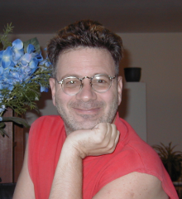
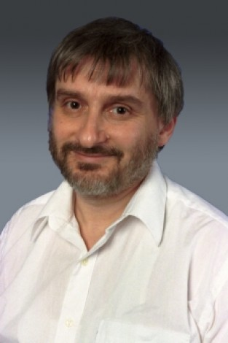
List decoding Walsh-Hadamard code
Goldreich-Levin Theorem
Goldreich
Levin
List decoding: output a list of candidates
Tool: pairwise-independent hash function to reduce randomness
h(x) and h(x’) are independent

Slide 58
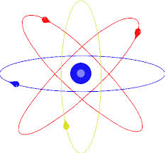
Part 3. Quantum zero-knowledge proof
Trust me, for no reason
OK
Merlin/Prover
Arthur/Verifier

Slide 59
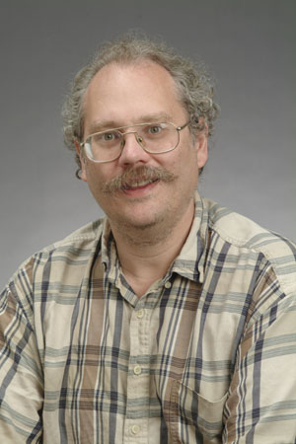
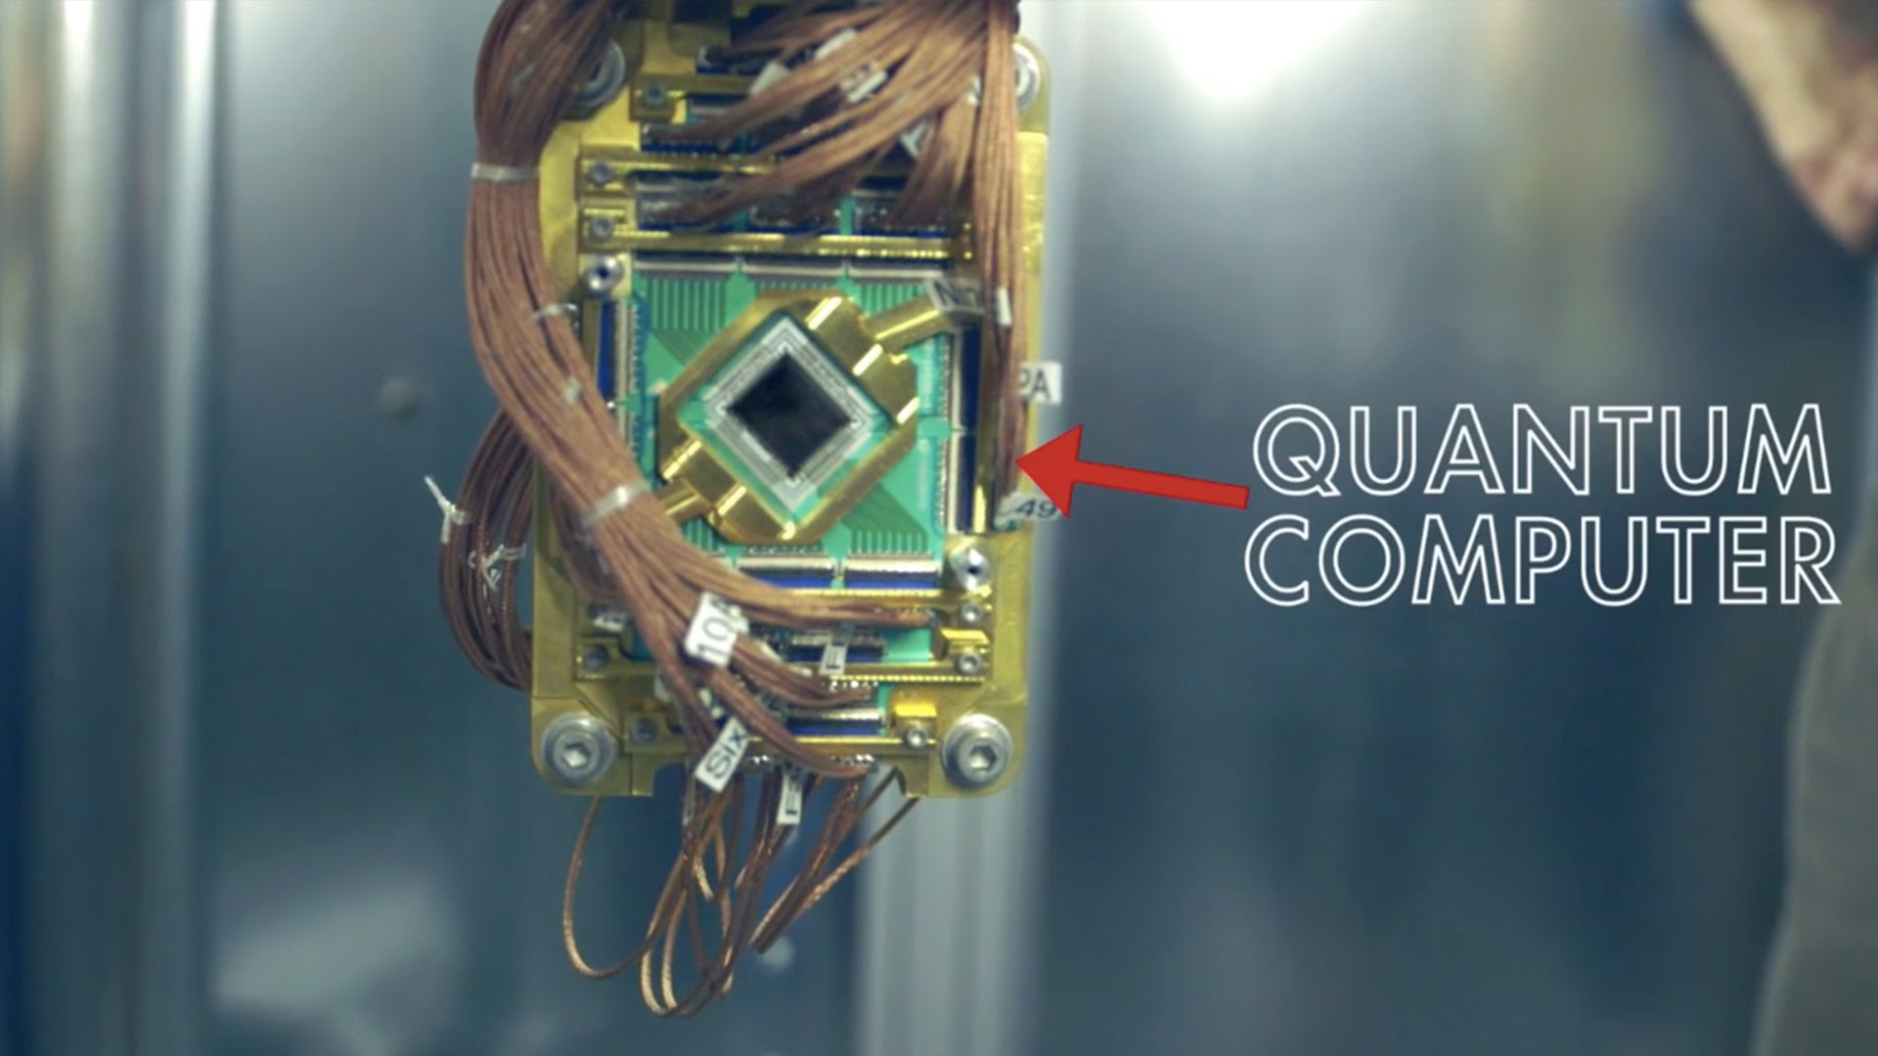
Quantum attack
Factoring
Discrete Logarithm
Peter Shor

Slide 60
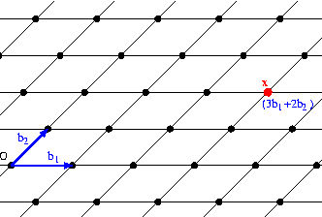
Post-quantum security
Classical construction
Secure against quantum computer
Securities based on the hardness of Factoring or Discrete Logarithm will be compromised in presence of quantum computer
Lattice-based cryptography

Slide 61
Fully quantum setting: my work
Quantum construction
Secure against quantum computer
Trust me, for no reason
OK
Merlin/Prover
Arthur/Verifier

Slide 62
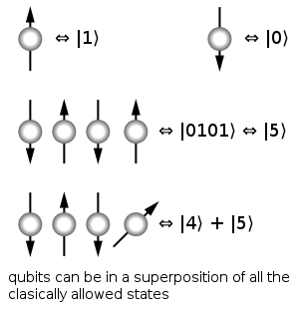
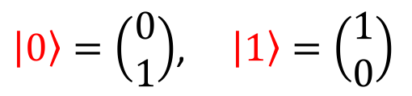
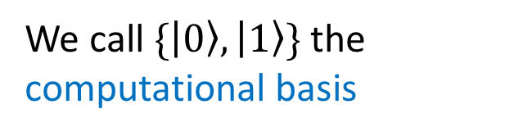
Qubit(s)
$|0〉=\left(\begin{matrix}0 \\ 1\end{matrix}\right)$, $|1〉=\left(\begin{matrix}1 \\ 0\end{matrix}\right)$
We call $\{|0〉,|1〉\}$ the computational basis

Slide 63
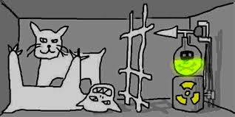
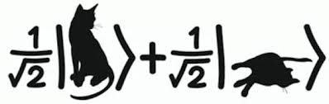
Measurement (Schrödinger's cat)
Measure: alive or dead;
Not measure: alive and dead simultaneously.

Slide 64
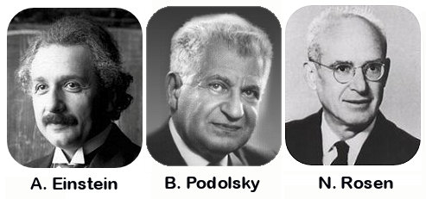
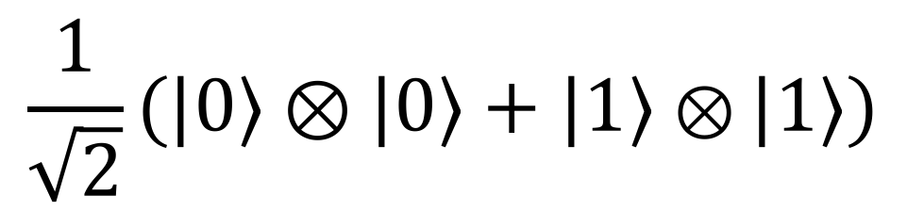
Entanglement
EPR pair:
$$\frac{1}{\sqrt{2}}(|0〉⊗|0〉+|1〉⊗|1〉)$$

Slide 65
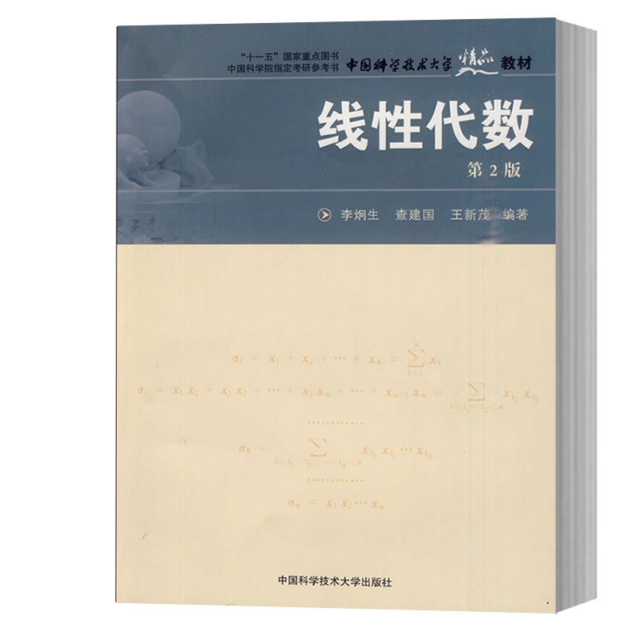
Quantum information vs. linear algebra
Pure state: Unit vector
Mixed state: Positive semidefinite operator with trace one
Observable: Hermitian operator
Operation: Unitary operator
Measurement: Projector, computational basis
李炯生，查建国，王新茂

Slide 66
Quantum zero-knowledge proof
Both the prover and verifier are quantum algorithms
The prover and verifier can exchange quantum messages
In contrast to the classical zero-knowledge proof against quantum attack, or post-quantum secure zero-knowledge proof

Slide 67
Quantum Bit Commitment Scheme
0
1
α
+β
Quantum binding appears much weaker

Slide 68

New problems
Quantum rewinding: generally cannot observe the adversary’s behaviors on more than one inputs
  Measurement collapses quantum states
  No-cloning theorem
Non-uniqueness of the string underlying quantum bit commitments
  Exponential blowup

Slide 69

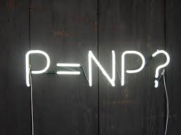

My Research
+
+
Cryptography
Complexity
Quantum

Slide 70
Conclusion
Many mathematics for the study of interactive proof (and Theoretical Computer Science at large):
  Number theory: Factoring, DLP
  Linear algebra: expander, quantum computation
  Abstract algebra: finite field, Graph Isomorphism algorithm
  Graph theory: isomorphism, coloring, Hamiltonian cycle
  Probability theory: everywhere
  Mathematical logic: completeness/soundness, SAT
  Coding theory: list decoding Walsh-Hadamard code
  …

Slide 71
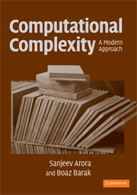
Three textbooks
Math and Computation
(To appear)
Introduction to Theoretical Computer Science
(Draft)
Avi Wigderson
Boaz Barak
Sanjeev Arora
Boaz Barak
(Link)
(Link)
(Link)

Slide 72

Trust me, for no reason
OK
Merlin/prover
Arthur/verifier

